Slide 1
Credit Card Consumption
Members:-Karun Kaul
Sachin Singh
Sushant Karande
Nawaz Mirza

Slide 2
Problem Statement
The Common Man Bank Ltd (CMB) wants to understand these patterns thoroughly and get insights on the customer details and the spending patterns. So from their database, they have prepared the data of sample customers and their transaction history
The Spends and Consumption Patterns of Credit Cards allow banks to build the to build strategic partnerships with vendors for discounts or other plans to reward and retain customers.
Banks can visulaize from the spending patterns and profile people based on spending and tailor the loans or financial products based on those.
It will be helpful for a bank to understand the relationship between the customer profile and their spending patterns.

Slide 3
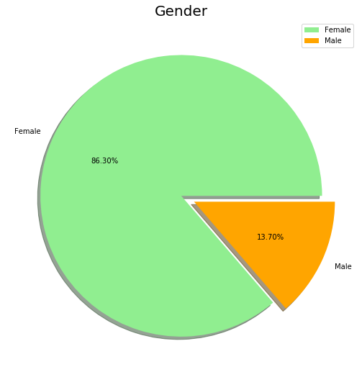
Pie chart of Gender stating that there are 86% females and 13% Males as credit card consumers.
Count:-
Male=11077
Female= 1767

Slide 4
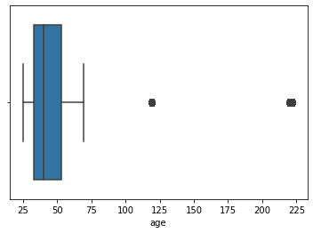
Handling Outliers in dataset.
As we can observe that there are outliers in Age column.
The Age is more than 200.
So to deal with this ouliers we need to perform some Feature Engineering.

Slide 5
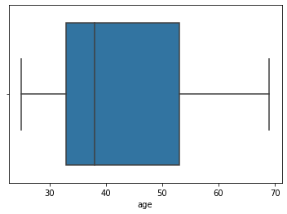
So to deal with ouliers in Age column, We had substituted the Age above 75
with the Median values.

Slide 6
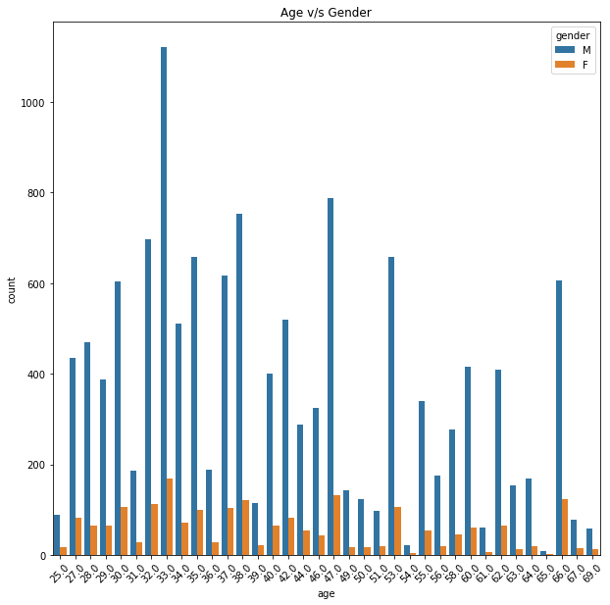
Count of Male and Females according to their Ages
In above graph,the blue bar indicates Males and Orange indicates Females.
The count of Males is more than the Females.

Slide 7
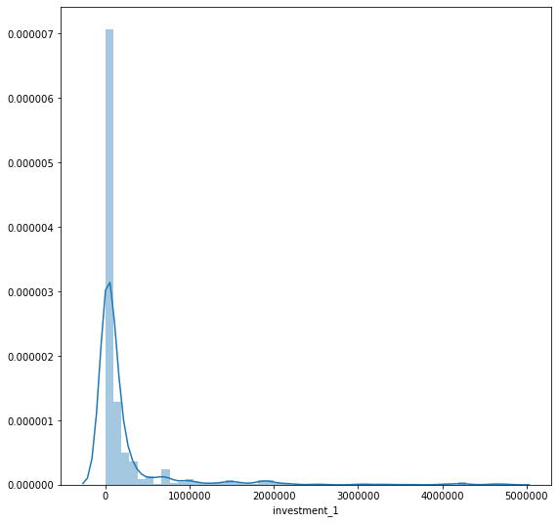
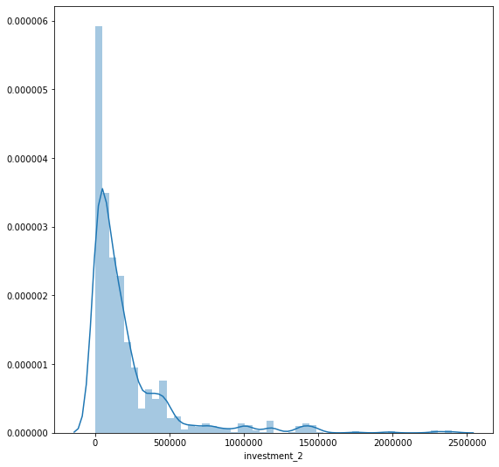
Displot of Investment 1 i.e.
Demat Investment in June
Displot of Investment 2 i.e Fixed deposit investment inJune.

Slide 8
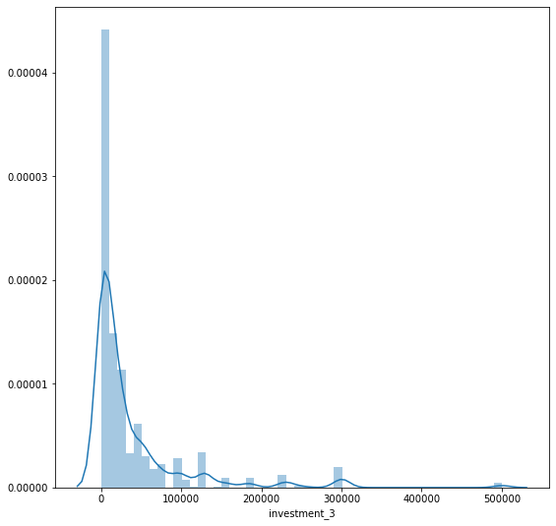
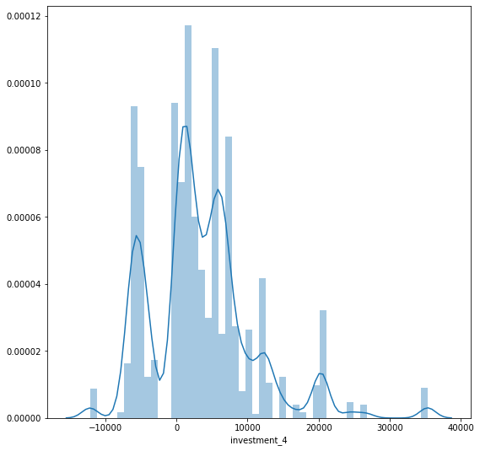
Displot of Investment 3 i.e. Life Insurance investment in June.
Displot of Investment 4 i.e
General Insurance in June.

Slide 9
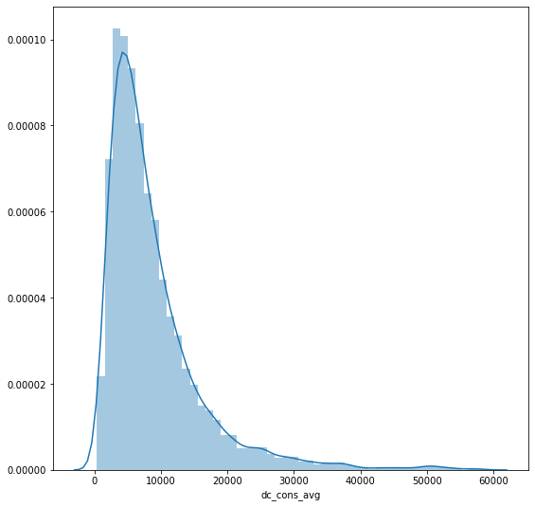
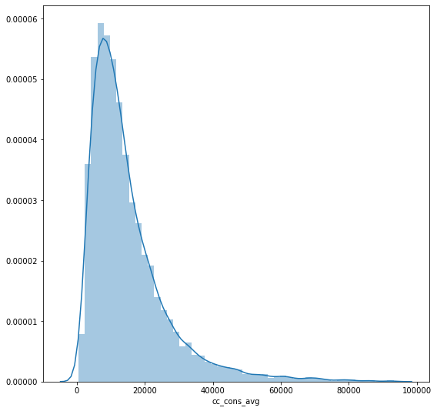
Average Displot of Debit consumption of 3 months and Average Displot of Credit consumption of 3 months.

Slide 10
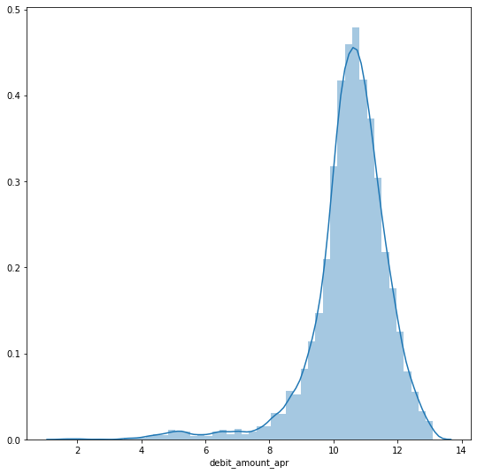
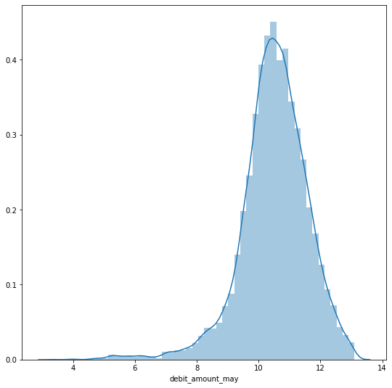

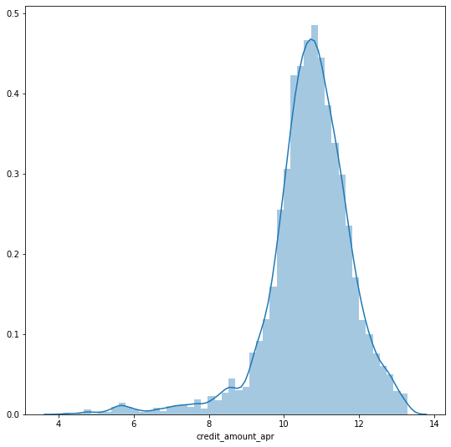
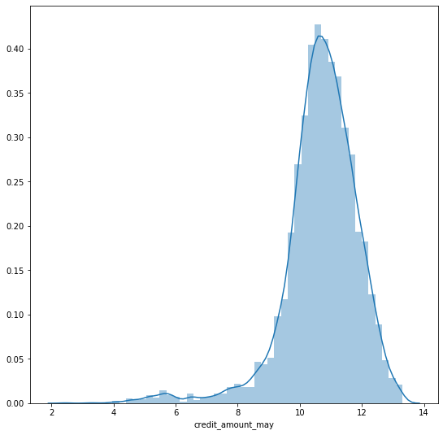
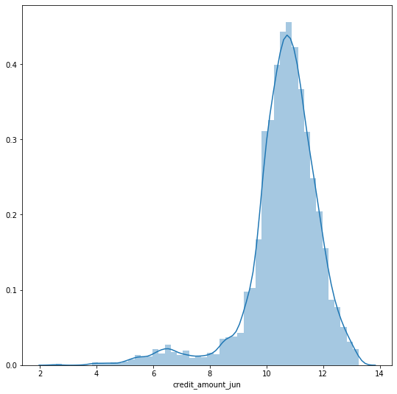
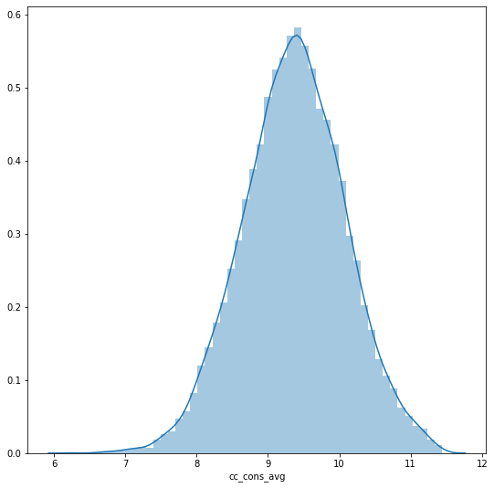
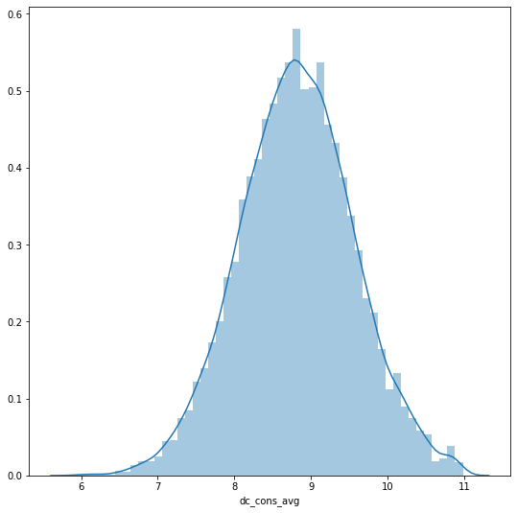

Slide 11
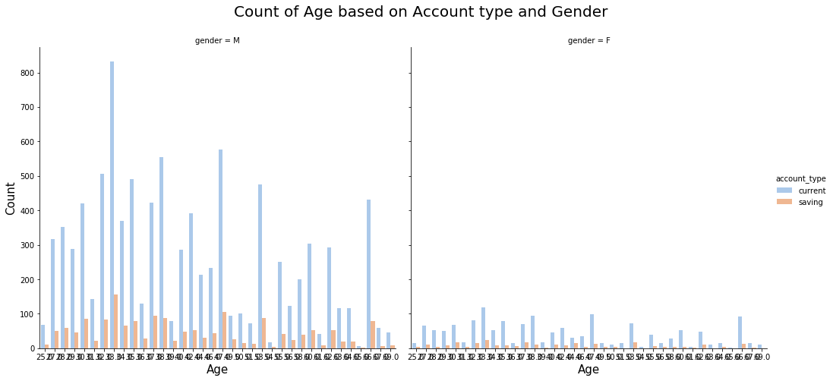
Relationship between Number of Age based on Account type and Gender.
There are more number of Males current account holder than females.

Slide 12
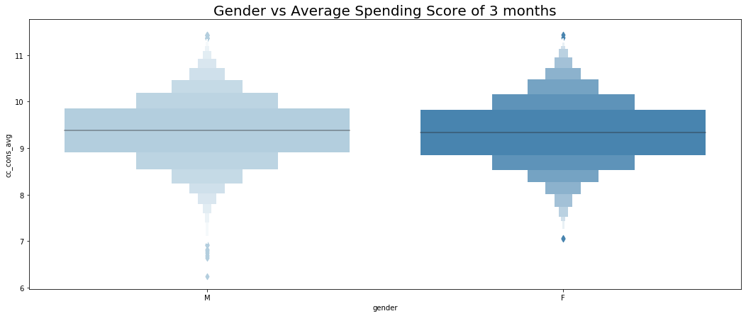
This is a Boxen plot showing the Relationship between the Gender and the Average Credit Spending Score of Three months.(April,May,June).
We can see that Credit Spending score of Males is more than the spending of Females.

Slide 13
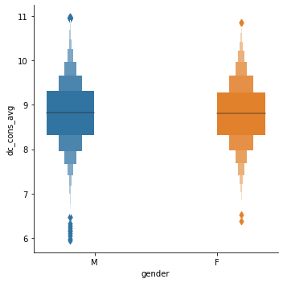
Realtionship between the Gender and Average Credit Card Spendings in 3 months
This is a Boxen plot showing the Relationship between the Gender and the Average Debit Spending Score of Three months.(April,May,June).
We can see that Debit Spending score of Males is more than the spending of Females.

Slide 14
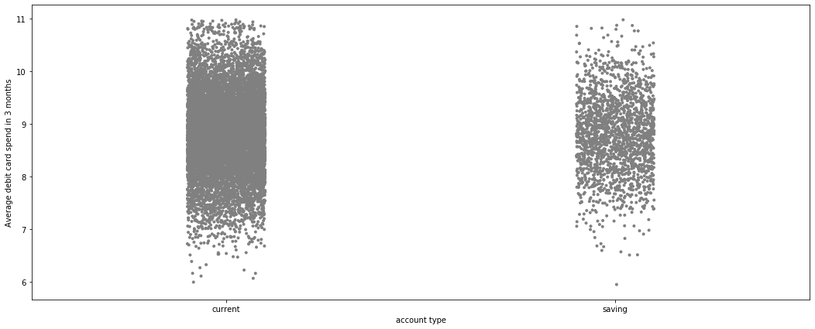
Relationship between Average Debit Card spend in 3 months according to Account Type
The Majority of Current Account holder Debit Spending is more than Saving account holder in 3 months.

Slide 15
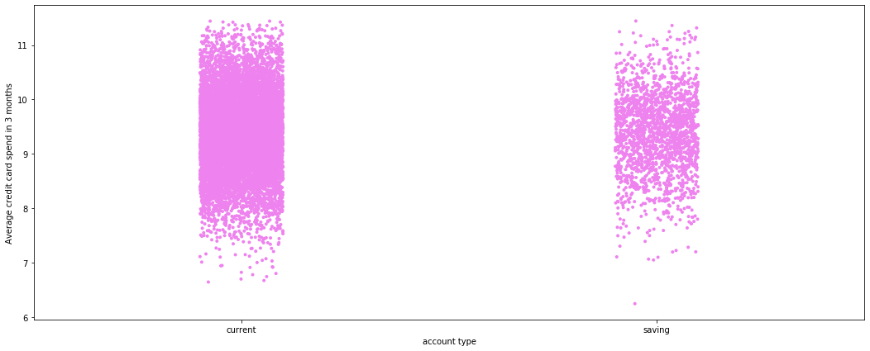
Relationship between Average Credit Card spend in 3 months according to Account Type
The Majority of Current Account holder Debit Spending is more than Saving account holder in 3 months.

Slide 16
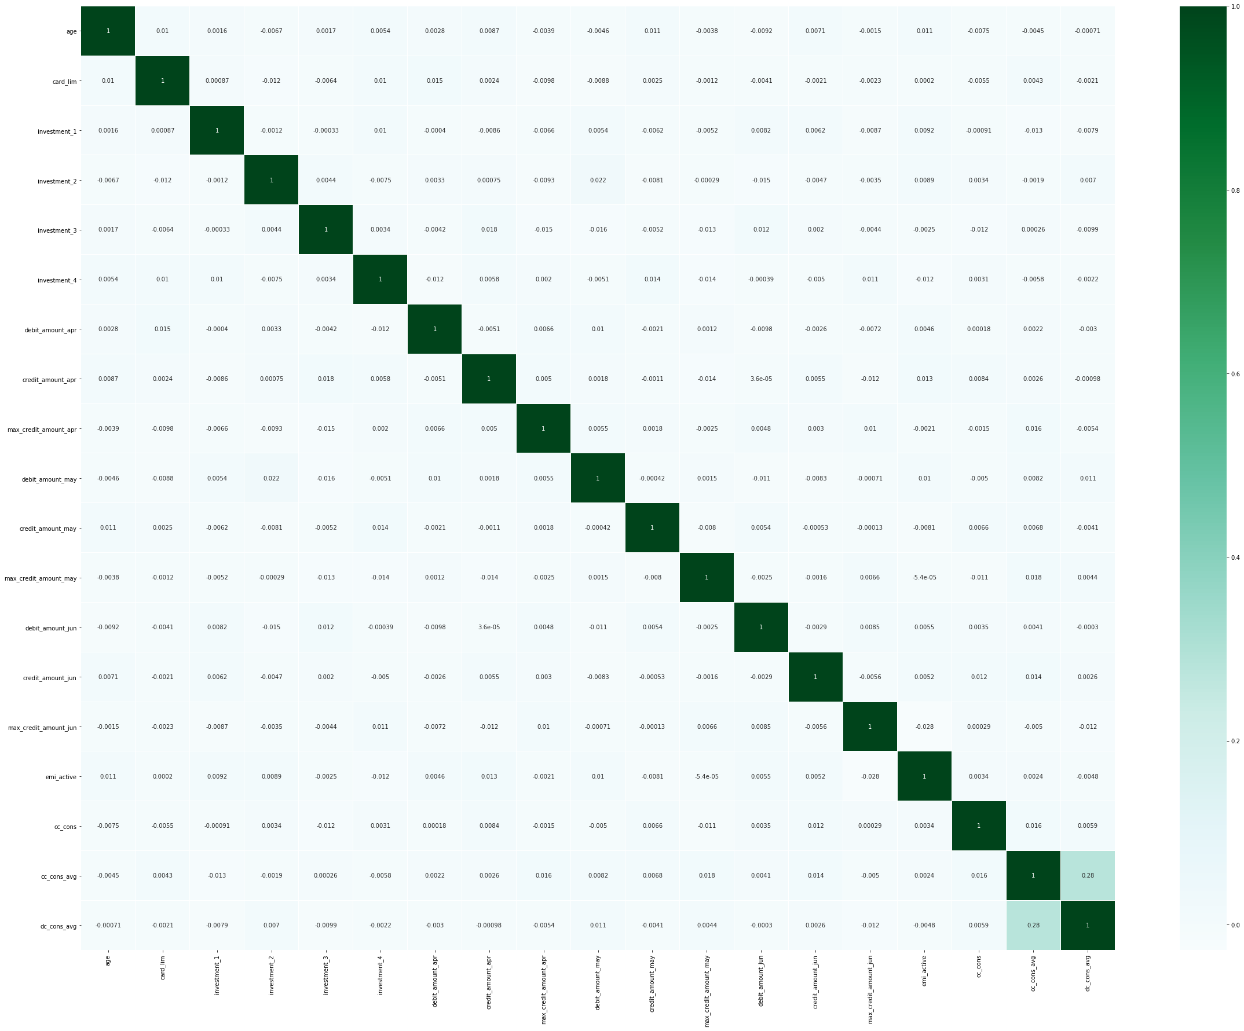
Visualization of Corelation

Slide 17
Model Building
For model building we have done linear regression.
We used other models such as RandomForestRegressor, RandomisedSearchCV.
The RMSLE score was similar and there was not much variance , Hence we chose to comitue with linear regression

Slide 18
CONCLUSION
Models | RMSLE score
RandomForestRegressor | 1.61
linear regression | 1.63

